Slide 1
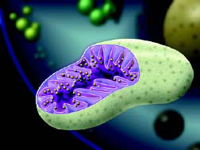
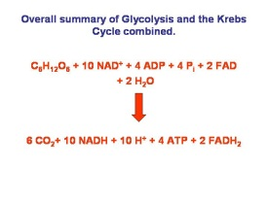
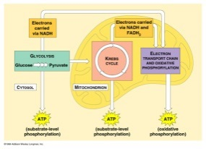
Cellular Respiration

Slide 2
Cellular Respiration
Cellular Respiration

Slide 3


Slide 4
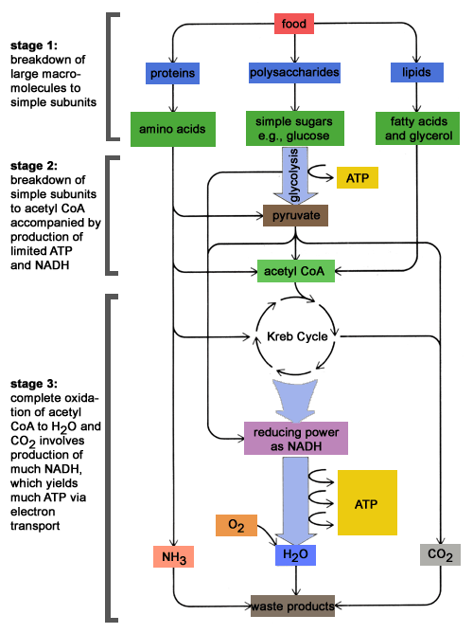

Slide 5
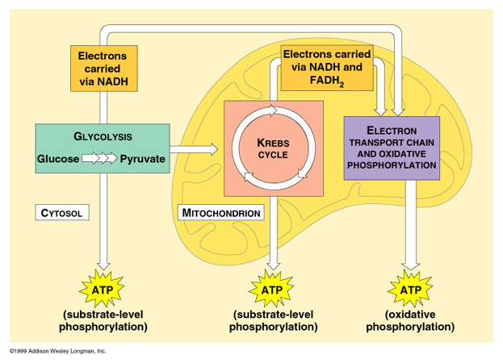

Slide 6
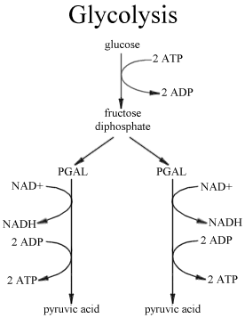
Control point in the production of ATP

Slide 7
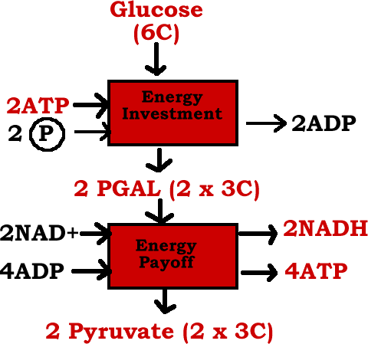

Slide 8
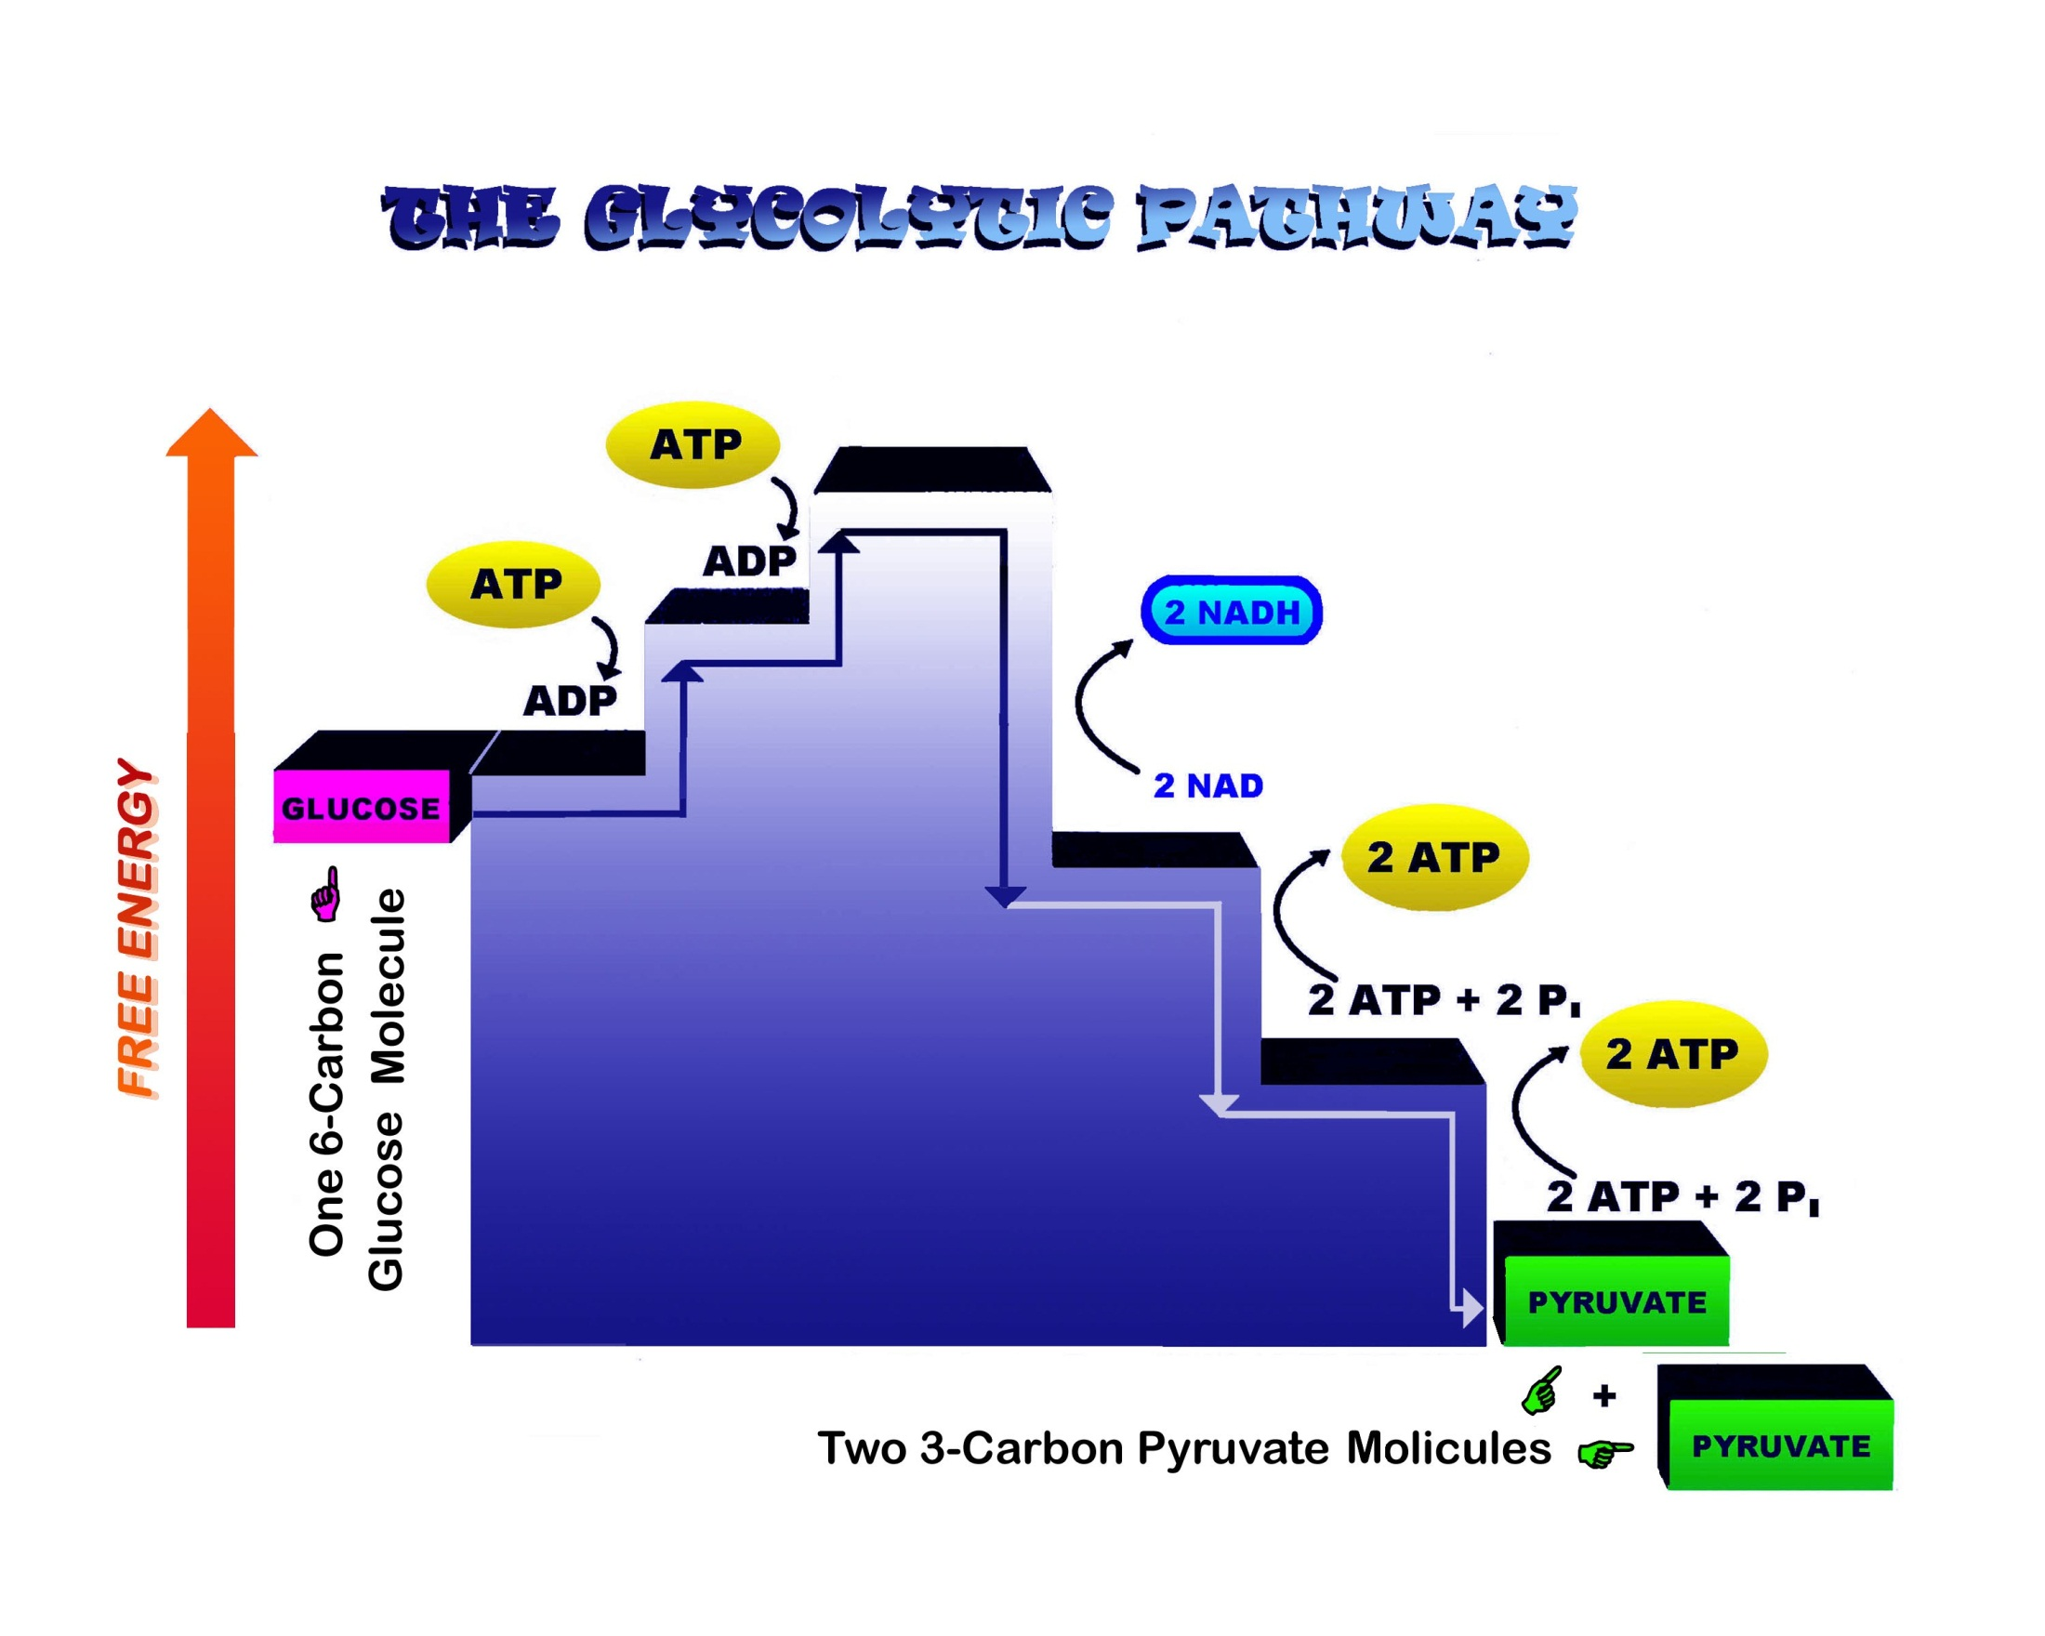

Slide 9
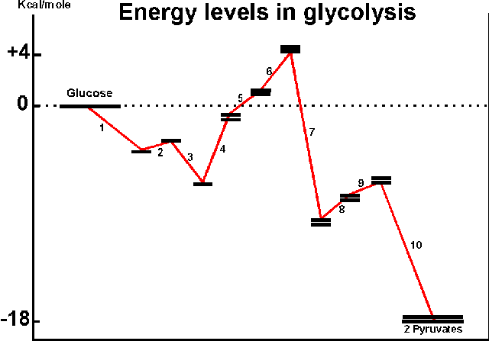

Slide 10
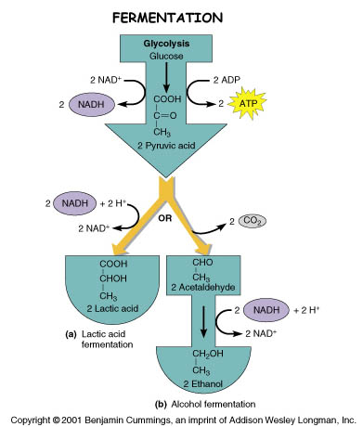

Slide 11
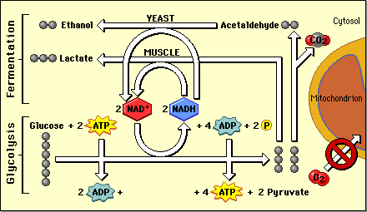

Slide 12
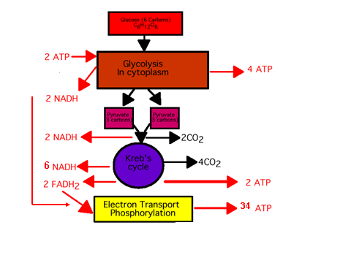

Slide 13
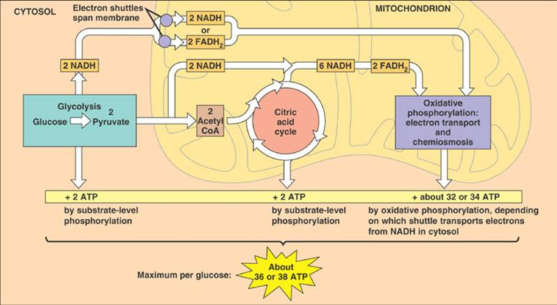

Slide 14
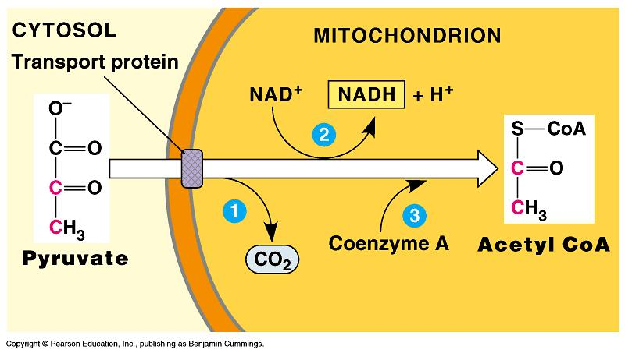

Slide 15
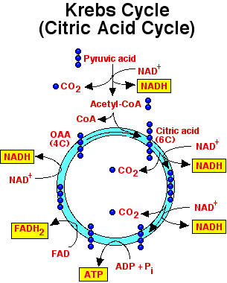

Slide 16
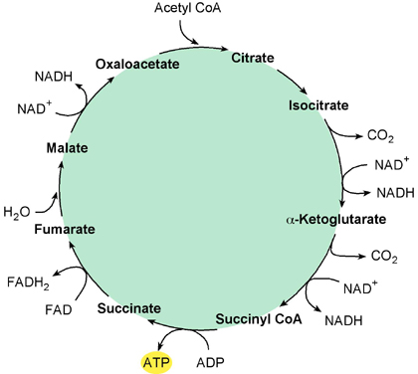

Slide 17
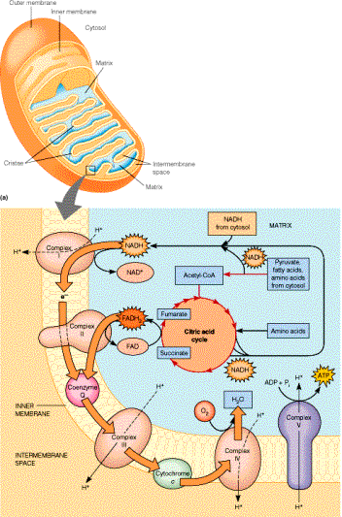

Slide 18
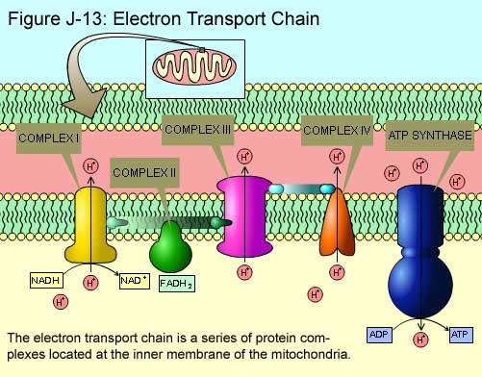

Slide 19
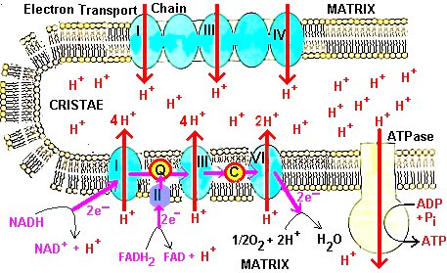

Slide 20
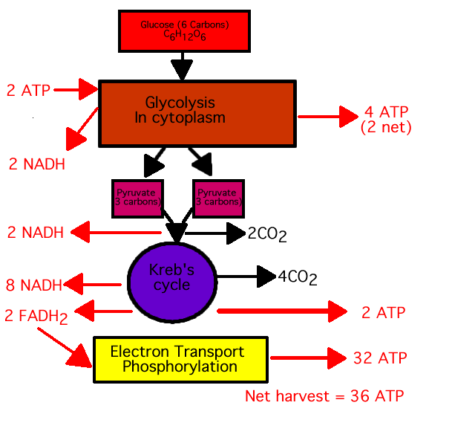
6
34

Slide 21
Glycolysis Animation:
http://www.youtube.com/watch?v=x-stLxqPt6E
Kreb’s Cycle Animation:
http://www.youtube.com/watch?v=aCypoN3X7KQ
Electron Transport Animation:
http://www.youtube.com/watch?v=xbJ0nbzt5Kw
ATP Synthase Animation:
http://www.youtube.com/watch?v=uOoHKCMAUMc

